Slide 1
THE MEXICO CLIMATE FINANCE INTEGRITY TALKS Talk 1: Corruption Risks in Climate Finance – An introduction
Lisa Elges – Climate Finance Integrity Programme, Leader
http://www.transparency.org/programmes/detail/cgip

Slide 2
Contents
What we do and do not know about climate finance.
How climate finance works.
Safeguarding climate finance against corruption.
The performance of existing climate funds.
Notes:
Having said that, how much can I cover in today’s presentation - I have broken it down into two main parts.
The first two slides attempt to help lead you in slowly to our rationale for embarking on this research process. I will start by recapping what we know about climate finance…..and what we don’t know. An I will give a brief introduction to how climate finance works.
The remaining slides will introduce the research that we have undertaken – the questions that we have asked and the results that are emerging which will then help frame the panel discussion that follows.

Slide 3
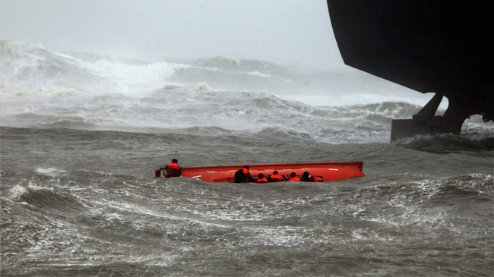
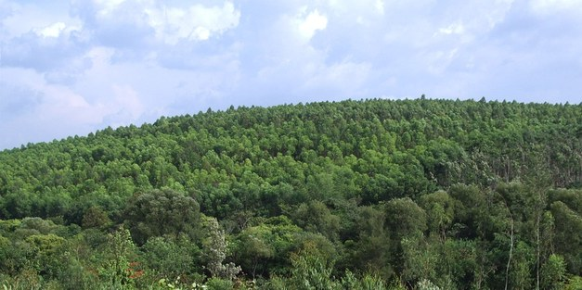
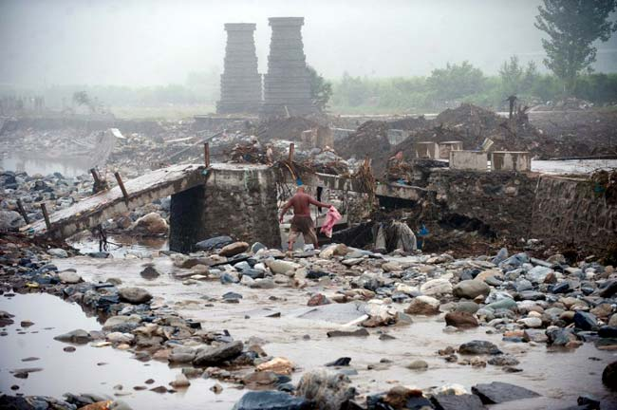
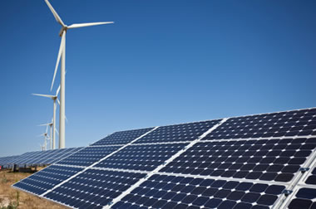
We know about the scale of the climate challenge
Notes:
So I wanted to start by recapping what we know about climate finance...and what we do not know.
We know the scale of the challenge.
We know that there are enormous challenges in terms of helping those countries affected by climate change to adapt to it. In the past year alone we have seen a number of disasters – cyclones from the Philippines to the Us, floods in Pakistan and India and droughts in Kenya and Ethiopia. These countries are desperately in needs of flood defenses and sea walls and investment in agricultural innovations to protect them against the worst impacts and to enable them to adapt to the challenges they face. We know that the cost of adapting to climate change runs to US$300-400 Billion per year.
We further know that GHG emissions need to peak by 2015 if we are to avoid even greater even catastrophic impacts. To achieve that we know we need trillions to be invested to construct wind and solar power facilities and to protect the world’s forests as the earth’s lungs.

Slide 4
We know the volume of finance is huge and growing
Notes:
We know that an increasing number of countries are contributing ever greater amounts to help finance climate work. By 2012 this amounted to US$30 billion and a commitment of USD$ 100 Billion/year by 2020 has been made.

Slide 5
We know that recipient countries face significant corruption challenges
Notes:
We know that many of the countries in receipt of climate finance are simultaneously struggling to control corruption. This map you see here is taken from the TI Corruption Perception Index. The darker the colour, the greater the perception of corruption.
My colleague Judy Ndichu in the following presentation will talk a bit more about he challenges that exist here from the Kenyan perspective. To set it in context now though I will give you an example from our chapter in Bangladesh who mapped vulnerable areas against investment in climate projects. They did not match. Suggesting the private interests of decision-makers can interfere to brush aside the needs of vulnerable communities.

Slide 6
What we did not know…
Donor Countries
Banks, UN Agencies and National Actors such as the National Environmental Management Agency in Kenya
Bilateral
Funding
Multilateral Funds:
e.g.
Adaptation Fund
Global Environmental Facility Funds
Climate Investment Funds
Green Climate Fund
Recipient Countries
Notes:
Finally, what we at TI at least, not know…..when the 100s of millions of public climate finance flows from donor to recipient countries so take for example from Ireland to Bangladesh, how can that government and we as tax payers as well as citizens in recipient countries be confident that the money gets to where it is needed and not lost to corruption?
To be able to answer this question, we first had to get to grips with the complexity of the channels through which the finance flows. On its way from donor to recipient countries, public climate finance may follow a number of paths - the bulk of it is channelled through RELATIVELY NEW multilateral funds. The AF and the GEF funds fund….the CIFs fund…. And the Green Climate Fund is a recent addition expected to channel US$100 billion per year will contribute to all.
A second important point to the complexity is that these funds, do not channel funding directly to recipient countries but though another multitude of actors – banks and UN agencies as well as national level actors.
The question then arises, within this complexity, is – is there clarity in terms of those who act corruptly will be held to account and to what extent protections are in place to avoid corruption in the first place.
It was out of this complexity and the many questions that it gave rise to that our research was born.

Slide 7
Safeguarding Climate Finance against corruption
What happens if corruption occurs within the funds?
What safeguards are in place to strengthen the fund’s ability to withstand corruption?
Interim findings based on publicly available information on three of the funds – full reports to be published later in the summer
Notes:
By asking two more…we looked both at remedial and preventative actions in place within multilateral funds.
REMEDIAL: What happens if corruption occurs – who is in the position to investigate, follow up and punish corruption at all levels within the fund.
PREVENTATIVE: What safeguards are in place – here were looking for some important preventative measures.
So we asked:
How transparent are the funds: is detailed information about money flows,
Is there detailed information spending decisions
And is there detailed information on decision makers.
We looked to see what provisions are in place for independent bodies to oversee processes to ensure they are clean.
We checked to see to what extent citizens (particularly those communities that are feeling the effects of climate change) are partners in the prevention and identification of corruption.
Do they have access to budgets and proposals to scrutinize?
Are they involved in decision making on what money goes where?
Do they have opportunities to voice grievances with the confidence they will not face punishment and will in fact find solutions?.
Finally before I proceed to the findings, a few disclaimers:
1. This presentation will not go into the methodology in detail: we have a detailed toolkit available which I will be happy to make available to anybody who is interested.
2. What is presented today are the interim findings with full research publication coming in the summer. Today I will focus on four key emerging challenges that will form the basis for discussion by the panel in terms of what can be done to address them.

Slide 8
What is a climate fund?
(Very) Simplified Fund Structure:
Governing Body
Trustee
Implementing entities
Secretariat
World Bank
World Bank, Asian Development Bank etc.
World Bank
UNDP
UNEP
National Institutions
Notes:
Before I jump into explaining the challenges – there is one important point about the three funds that I would like to emphasize and that is that the funds are not stand alone institutions but involve a number of existing institutions. I will try to demonstrate this a simplified graph and then explain why this is important.
CIFS, AF and GEF are not institutions in themselves but partnerships of existing institutions
What does this mean: take for example the four key “bodies” within the fund:
The Governing Body – makes decisions..
The Trustee – receives money from donors and distributes it to implementers.
The Implementing Entities – They design and apply for funding to implement projects.
Secretariat provides support to the funds activities.
Now when you lift the veil on this, something surprising at least for me emerged:
The Governing body is however the only body unique in each fund made up of representatives of both donor and recipient countries, in different measures, but nevertheless unique. WB fulfills the trustee function for all three funds. For IEs - again all existing institutions including some usual suspects such as WB, UNDP, etc. AF has also national entities. Secretariat Functionally independent from the World Bank but nevertheless “world bank” contacted staff.
Why am I telling you this – it underpins the complexity of the funds and our ability to answer the two questions: what if corruption happens and what safeguards are in place to prevent it.

Slide 9
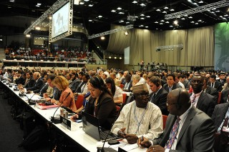
The performance of the funds
Global Accountability
Project Cycle Monitoring
Complaints Mechanisms
Notes:
The research revealed both challenges at the global level and at the local level.
Global Accountability
Day to day reporting lines within the funds were found to be relatively clear.
Investigation and punishment for any world bank staff member who engages in corruption are also comprehensive and clear.
Hhowever, accountability for cases when corruption happens regarding executive decision-makers such as Board or Committee members of climate funds is not so clear.
So to take as an example a member of the executive who has to make a decision on which of two projects to fund – one from Honduras, one from Kenya. Now, if he takes that decision based on a personal or business interest, he has acted on the basis of a conflict of interest. So what happens?
The AF is the only fund whose documentation openly discuss what would happen in cases of misbehavior of this time and sets out a procedure which could lead to removal from the board – but beyond that there is silence.
Beyond that, it seems that these executive decision-makers which are nominated by and represent their national governments would be ultimately accountable to public institutions in their sending countries – to take just the adaptation fund as an example that would be 16 sets of rules.
Project Cycle Monitoring (pipes example)
Part of our assessment was to consider consultation with civil society and participation throughout the project cycle. This is because it is clear that corruption as well as other abuses can happen downstream and can impact on project results and in some cases even have adverse effects on people and the environment. At present however, our research has shown that this type of monitoring is currently not built into the policy design of multilateral climate funds. The three funds under review have each got some requirements at fund level in terms of participation during the design and approval stage of projects. After that, although some steps have been taken to address this issues, the funds are largely silent and the policies and procedures of implementing entities apply.
Complaints
At the level of implementation as just discussed, the climate funds do not themselves provide policy guidance on fiduciary standards e.g. the GEF and Adaptation Fund makes clear that a complaints mechanism is required but are silent on what they may look like – rather they rely on the rules and procedures of implementing agencies. This makes chains of accountability have become complex, for example, where in one countries multiple agencies are engaged applying different standards and compliance rules. So, for a citizen – any stakeholder – who witnesses or is a victim of corruption or fraud or who suffers from social or environmental abuses, the accessibility of anti-corruption hotlines and grievance (redress, complaints) mechanisms becomes confusing and often untenable. Only the AF makes some effort to spell out what these are – by providing lists of email addresses on the fund website, but even from that list it is clear that some of the core best practices of a complaints mechanism such as the option to make a complaint confidentially are not met.

Slide 10
Thank you

