Slide 1
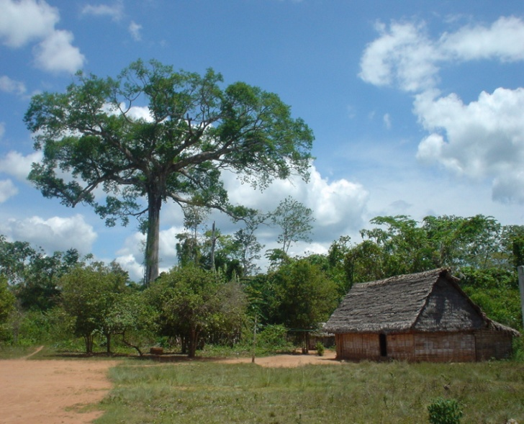
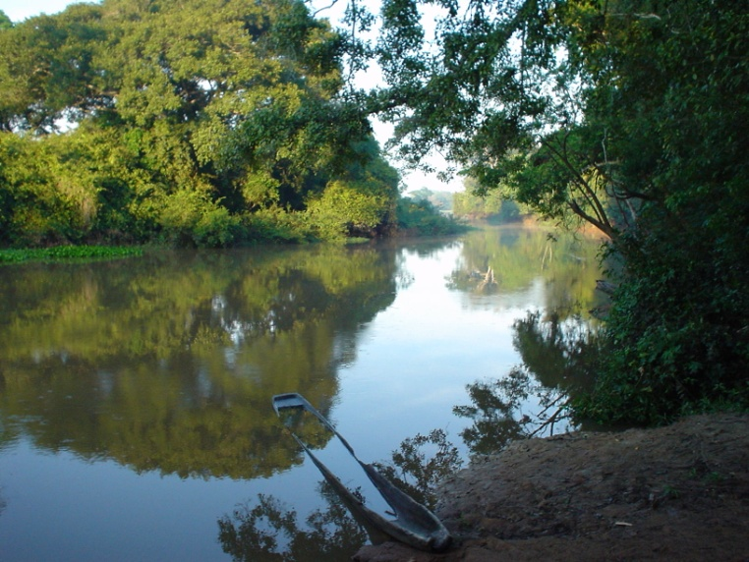
Gobernanza sobre los Bosques : Se basa en ¨La Canasta de Derechos¨ y Reglas de Juego
Evento
Gobernanza Forestal en América Latina
Transparencia México
Y
Consejo Civil Mexicano para la Silvicultura Sostenible

Slide 2
Distribución de la ´Canasta´de Derechos de los Regimenes de Propiedad Colectiva
Bundle of rights
Access to archaeological sites (guiding tours)
Customary settlement rights (40ha / family)
Access
-Extraction of timber under management plan
Illegal logging
Extraction of NTFPs
agrocultivation and pasture , hunting (subsistence)
Withdrawal
Regulation and allocation of concession rights for timber and non-timber extraction and petroleum and gas
Management of Agricultural plots and pasture
land management plan & use decisions for timber and non-timber agriculture and pasture
Management
Ilegal land grabs and selling of land improvements
 | *Regulatory basis
ç | de jure
 | De facto
 | Customary
 | Ilegal action
Exclusion
Exclusion rights to concession contract
Maintains alienation rights
Alienation
State
Cooperative
ACTUNAC
COCODE
Individual
Collective “Community of Carmelita”
Holders of Rights
Source: Own elaboration based on fieldwork
Notes:
The concession model ‘open up’ or allows for the recognition of a collective entity in large forest areas. The new legal framework in support of the model required the existence of a collective entity with legal recognition, to substitute the industrial firms previously playing this role
While other concessionaires chose the figure of civil association or society, Carmelita concessionaire members organized into a cooperative. In this community, through this collective entity, individual use rights around NTFP, hunting and fishing were recognized though not formally regulated. The collective entity that holds the concession right becomes the allocator and manager of those rights. However, in reality NTFP, agriculture and pasture activities are still managed under de facto agreements (shown in green).
With the new concessionaire organization established a relationship emerges based on membership status. This relationship is important taking into account that the transference of decision making rights from the state to the collective granted exclusive rights to the members of concessionaire organizations. (1) the concession served as an ‘umbrella’ for legitimizing, but not formalizing all of the forest related activities, except timber harvest. In part due to the fact that except from gum, NTFP’s are not yet legally regulated
First, it shows the evolution from de facto individual rights of access, use and extraction, that were informal which, through the process of establishing the concession were brought under collective control. Second, it evidences the transference of decision making rights from the state to the concessionaire organization. A series of conflicts emerge from both changes.
Forma or de jure regulation was developed for the commercially valuable resources, mainly timber and gum, but without taking into consideration their relationship to other forest resources, much less the implications for sustainable management. No thought was given to the ways in which user rights of one group would affect those of others.

Slide 3
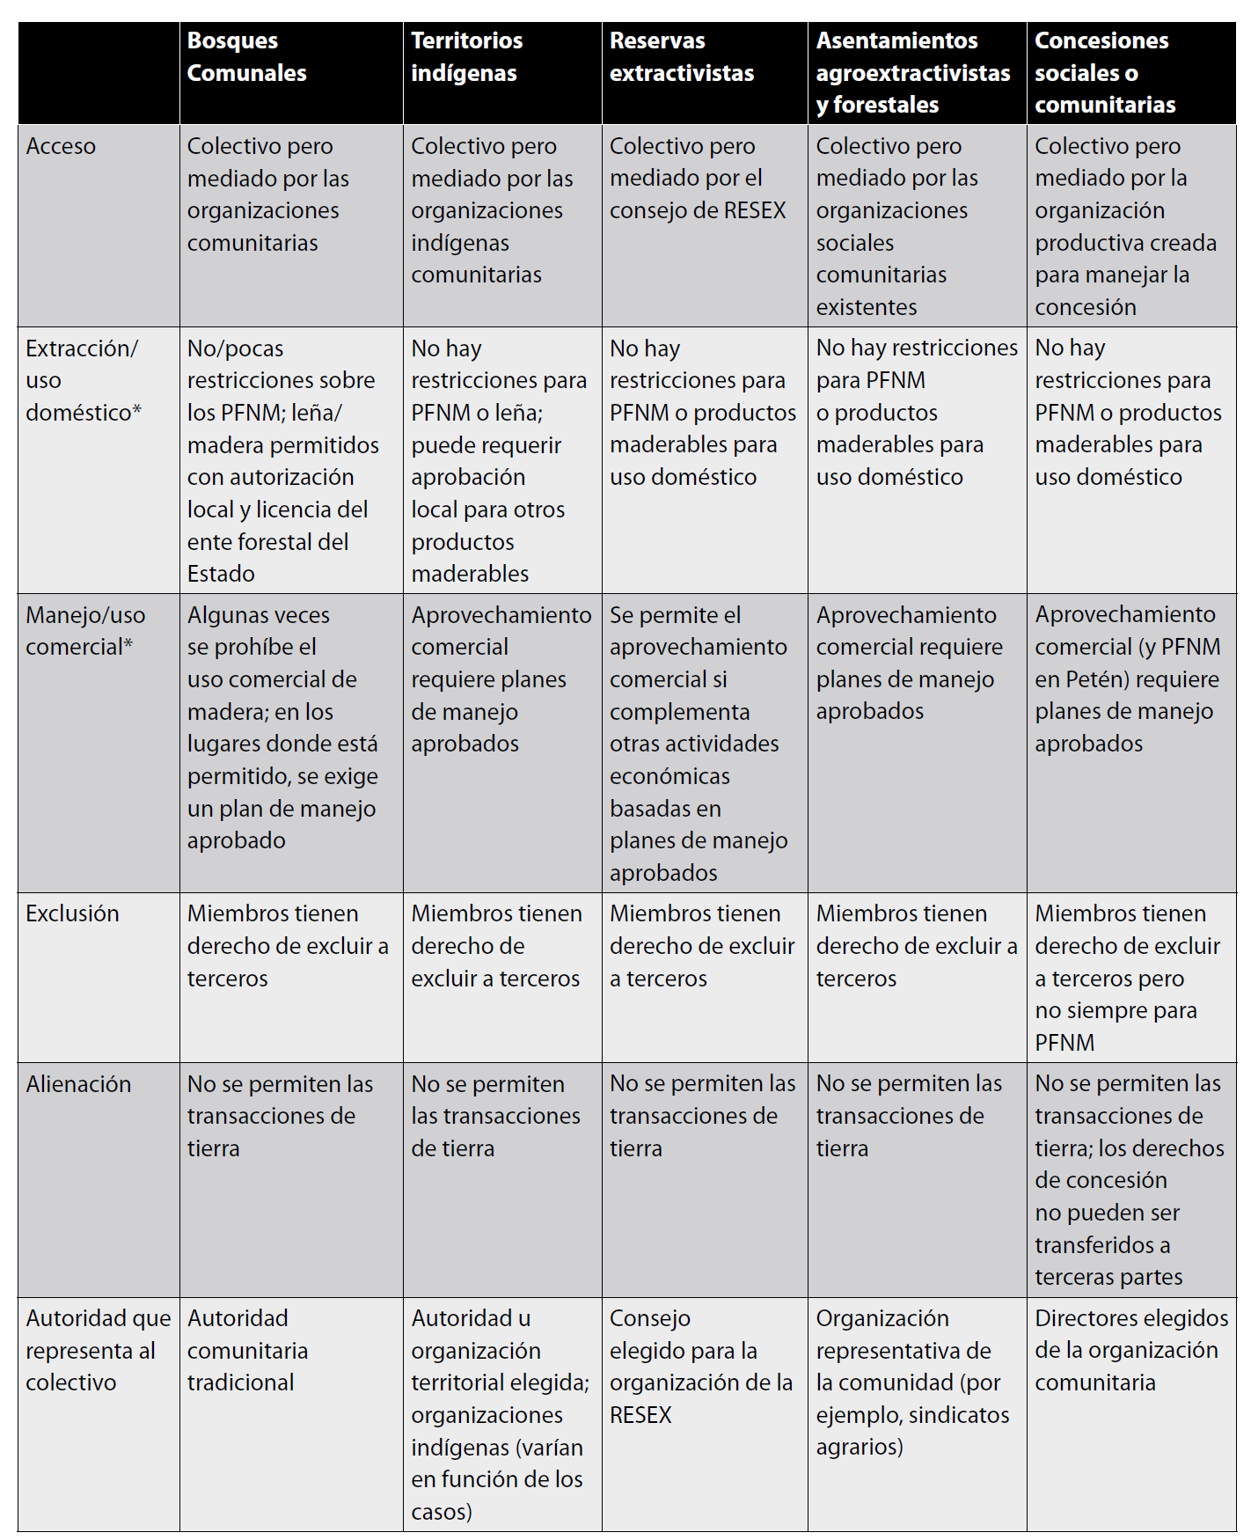
Notes:
Concessionaire members are not resident in the MUZ.
The community concession of Arbol Verde was attained through collective action, under the new legal framework that allowed members of communities to organize and form the civil association of Arbol verde, to have decision making rights in this concession. Without the concession, Arbol Verde would not have had access to the usufruct or management rights of timber and non-timber resources
Since Arbol Verde organized and has taken legal ‘possession’ of the concession area, the open-access conditions that favored illegal activities including logging and archaeological looting have been significantly reduced
Another significant difference in the case of Arbol Verde is that other traditional users, not belonging to this concessionaire organization, which previously extracted NTFPs under de facto agreements in this area have lost their claims. This is particularly relevant especially over commercially valuable resources such as gum and xate-palm.
The reforms actively promoted the creation of collective entities, by requiring organized collectively to obtain legally recognition as a prerequisite for becoming the new holders of those rights. The cooperative Carmelita and the Association Arbol Verde became the principle vehicle and receptor of these rights. Collective property regimes are frequently found in forested landscapes
Existence of social relations and institutions that govern access to and use of land and natural resources (difference with agricultural reform)
Relationship between the individual residents and the new collective entity are important when looking into representation and accountability issues. This is highly complex and differs among the two different concessions organization. Carmelita struggles to incorporate all community residents within the collective, enhancing participation and promoting distribution of benefits not only through the creation of jobs but also increasing cooperative investments at the collective level such as in promoting education. In the case of Arbol Verde the relationship between the collective entity and the nine communities diffuses given that this organization is only one of the many existing in the communities represented.

